Slide 1

Leveraging Cohort Analysis for Strategic Growth in E-commerce
Ihsan Karaosmanoglu

Slide 2



Agenda
1- Data Overview
2- EDA
3- RFM Analysis
4- Customer Segmentation
5- Applying K-Means Clustering
6- Cohort and Conduct Cohort Analysis
7- Conclusion & Key Findings
8- Questions and Discussion

Slide 3




Introduction
Project Title: RFM Customer Segmentation & Cohort Analysis Project
This is the first capstone project series of 3
Overview of the project focus: RFM Analysis, Customer Segmentation, K-Means Clustering, and Cohort Analysis

Slide 4
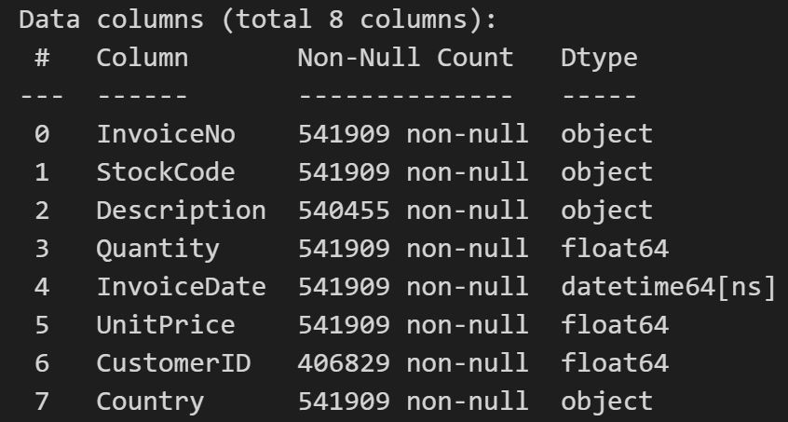
Dataset
Online Retail dataset from the UCI Machine Learning Repository
8 columns, mixed data type.

Slide 5
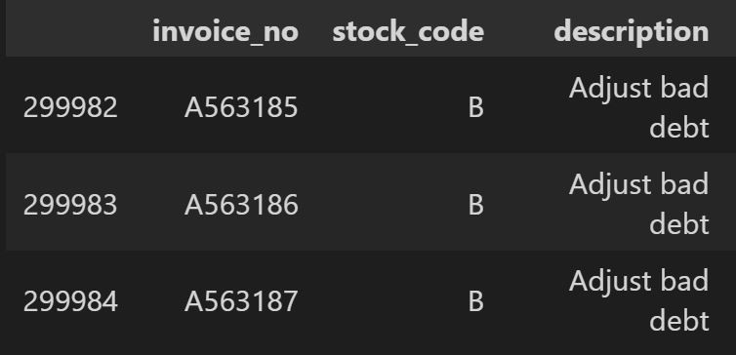
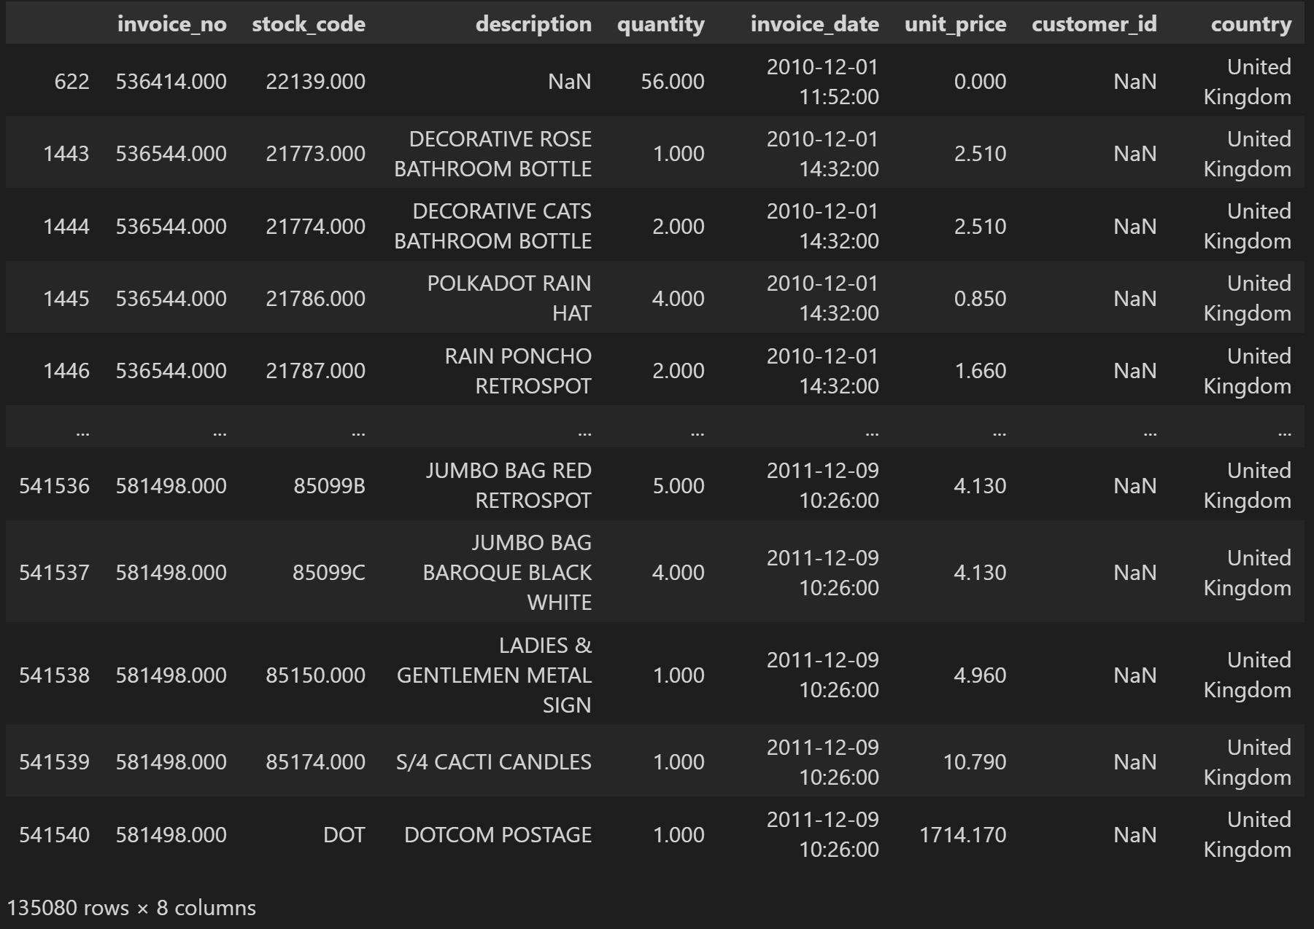
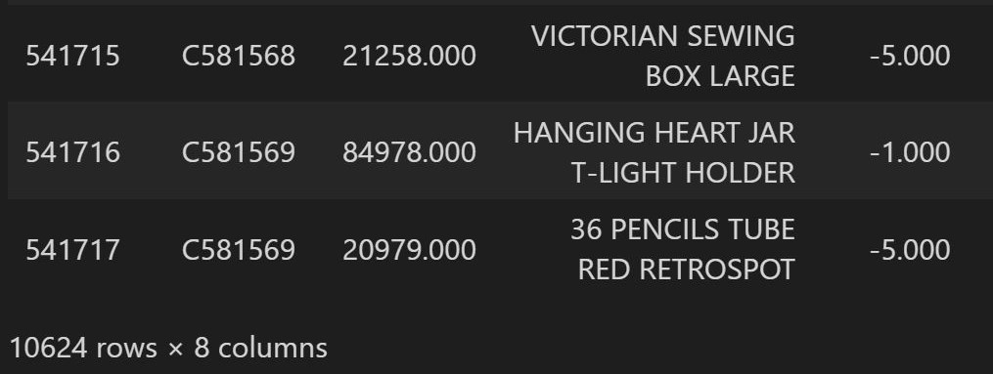
Handling Missing Values and Data Cleaning
There are invoice numbers that start with letter “C” and letter “A”
There are more than 135k missing customer_id values.
No missing values after we drop them.

Slide 6
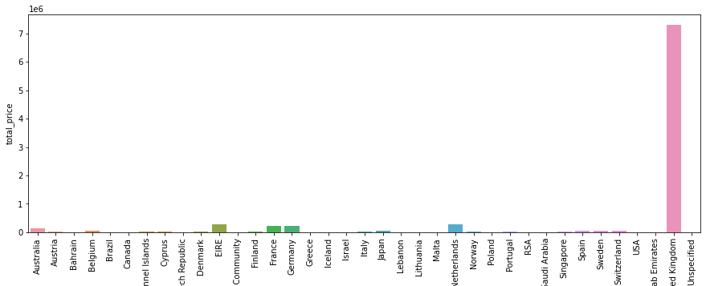
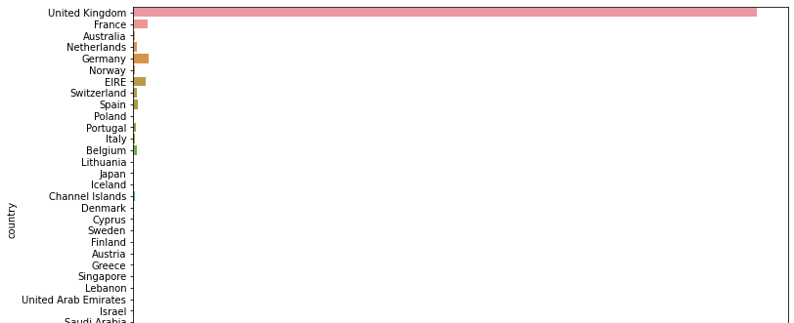
Exploring Orders, Customers, and Countries
Analyzing distribution and patterns of orders, customers, and countries
Importance of understanding sales policies and resource allocation based on these analyses
Focusing on UK transactions for the subsequent analyses

Slide 7
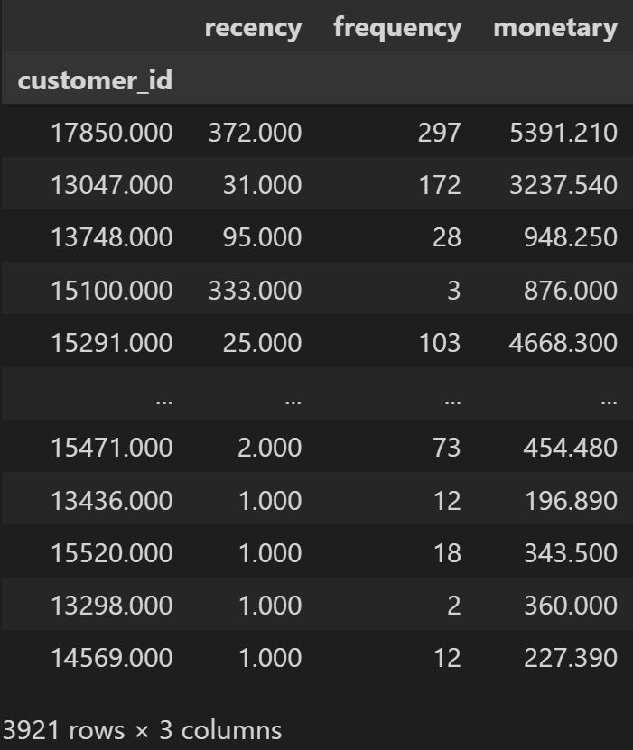
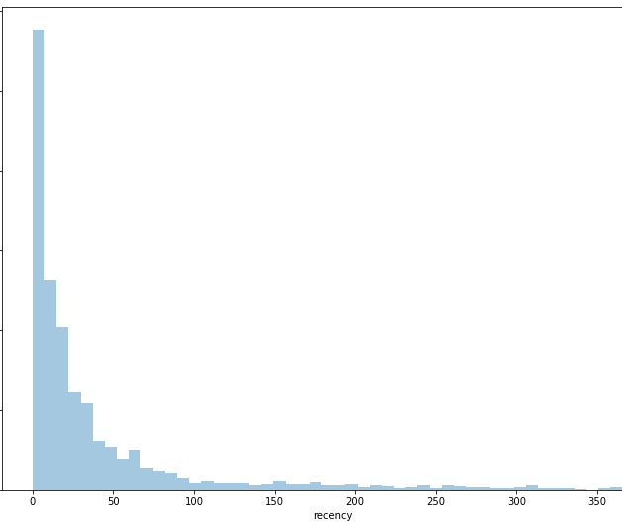
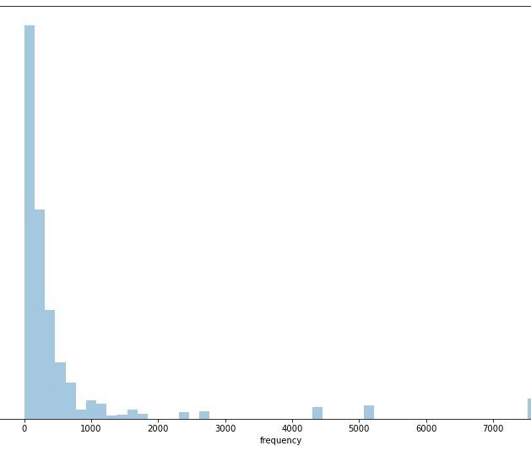
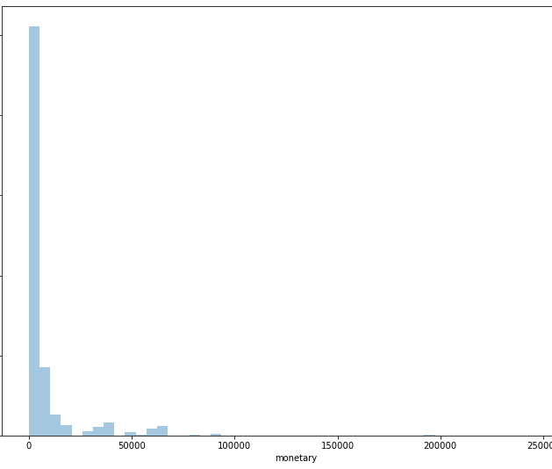
RFM Analysis
Recency
Frequency
Monetary
RFM Table
Introduction to RFM Analysis and its significance in customer segmentation
Calculation of Recency, Frequency, and Monetary values
Creating the RFM table

Slide 8
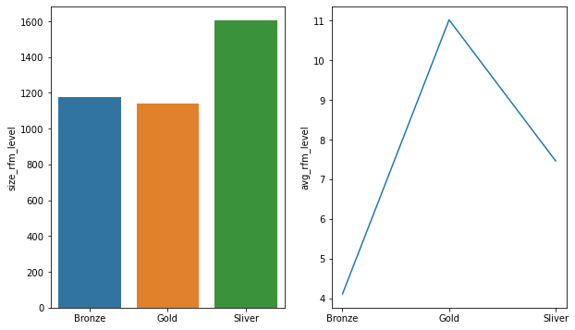
Customer Segmentation with RFM Scores

Slide 9
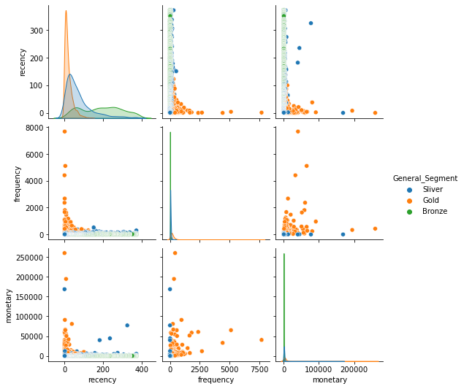
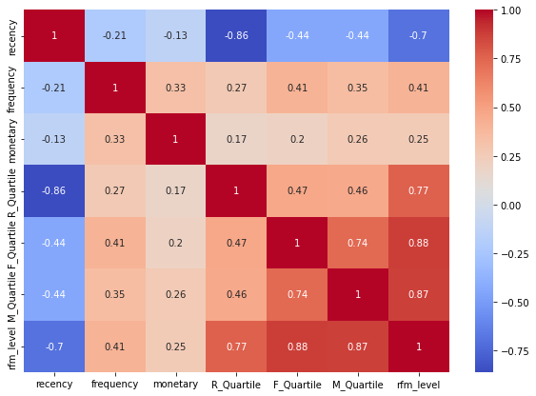
RFM CORRELATION WITH SEGMENTS
RFM CORRELATION

Slide 10
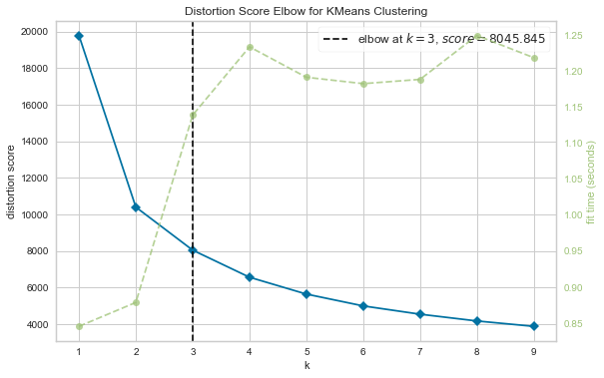
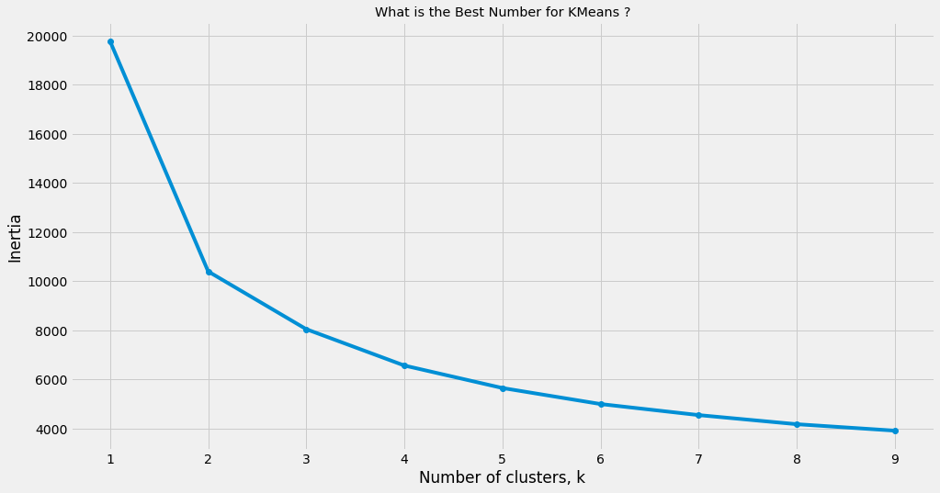
Finding the Best Number of K-Means (Elbow Method)

Slide 11
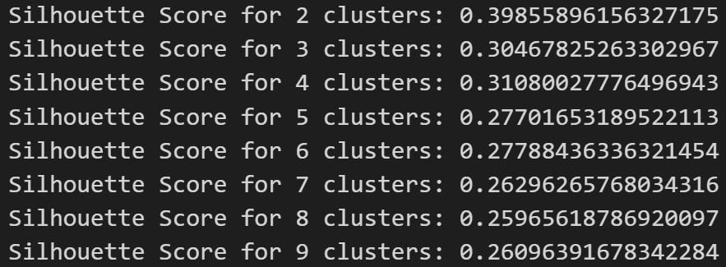
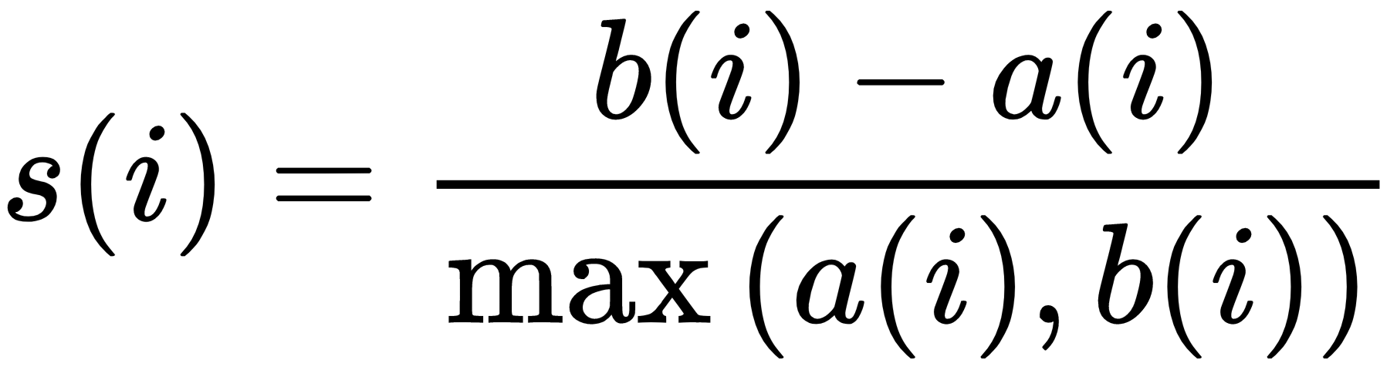
Silhouette Scores

Slide 12
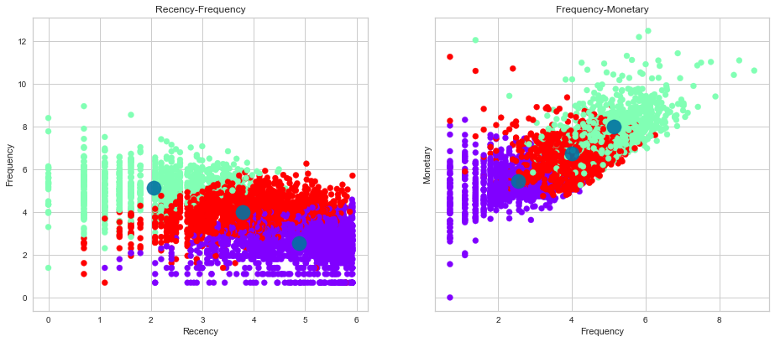
Visualizing Clusters

Slide 13
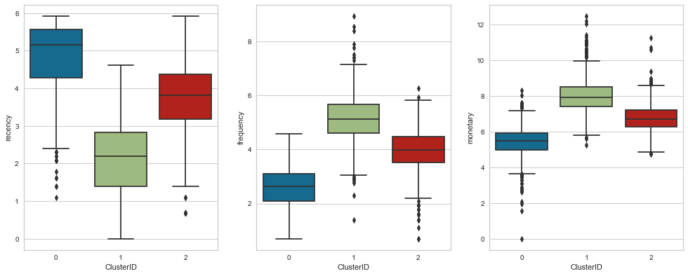
Cluster ID VS. RFM

Slide 14
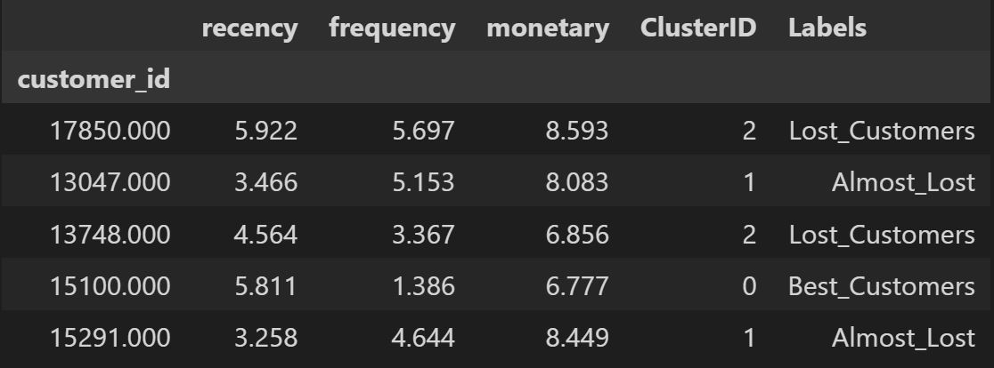
Labeling Customers
Lost Customers: High recency values. Their frequency and monetary values may vary.
Almost Lost Customers: Somewhat high recency values but might still have decent frequency and monetary values.
Best Customers: Low recency values and high frequency and monetary values.

Slide 15
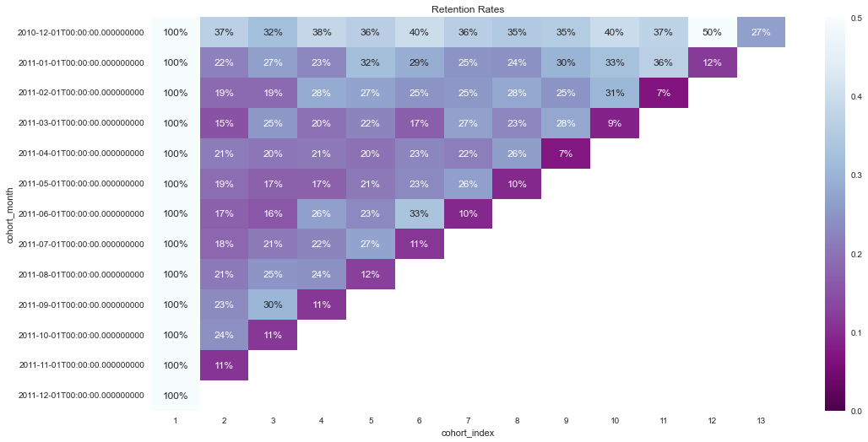
Analysis of Cohort
Retention Rate
High retention rate indicates a strong level of customer loyalty and satisfaction

Slide 16
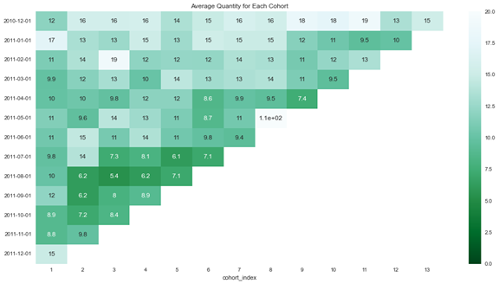
Analysis of Cohort
average quantity purchased by each cohort
How much each group is buying when they engage with the company.

Slide 17
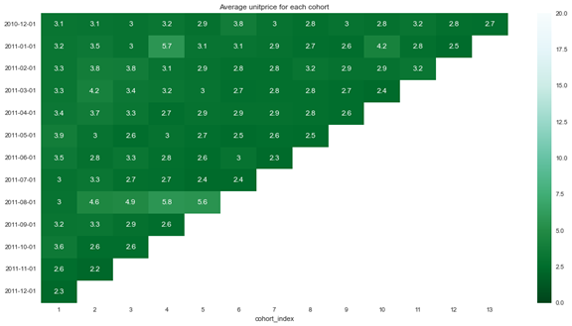
Analysis of Cohort
average unit price for each cohort
Insight into the spending habits of different customer groups and help us understand which cohorts are inclined towards our higher-priced offerings

Slide 18

Summary
This multifaceted project has facilitated a comprehensive understanding of customer behavior, fostering better decision-making, increased customer retention, and enhanced sales revenue.

Slide 19


Thank You
Ihsan Karaosmanoglu
Student Number: DA4204
Find my open-source code for this project on my github account: github.com/ihsankoo

